Slide 1

#DKGame
https://www.kb.dk/arrangementer/udstillinger/dkgame-skaermtrolde-lejemordere-og-togsurfere

Slide 2
Games at the Royal Danish Library
Ashley Kelleher Information Specialist, Digital Cultural Heritage – Copenhagen
Max Odsbjerg Pedersen Special Consultant, Aarhus University Library – Aarhus
Born-Digital Collections, Archives and Memory School of Advanced Study London

Slide 3
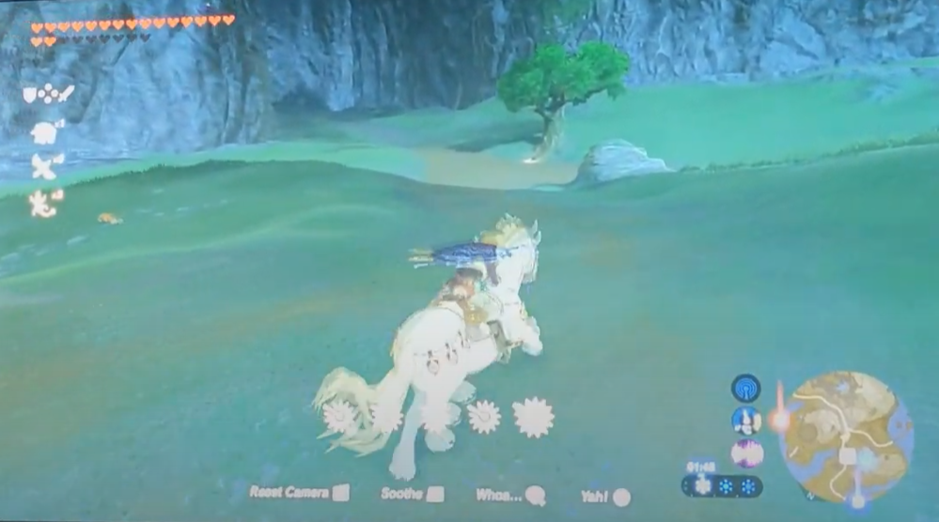
Hello!

Slide 4
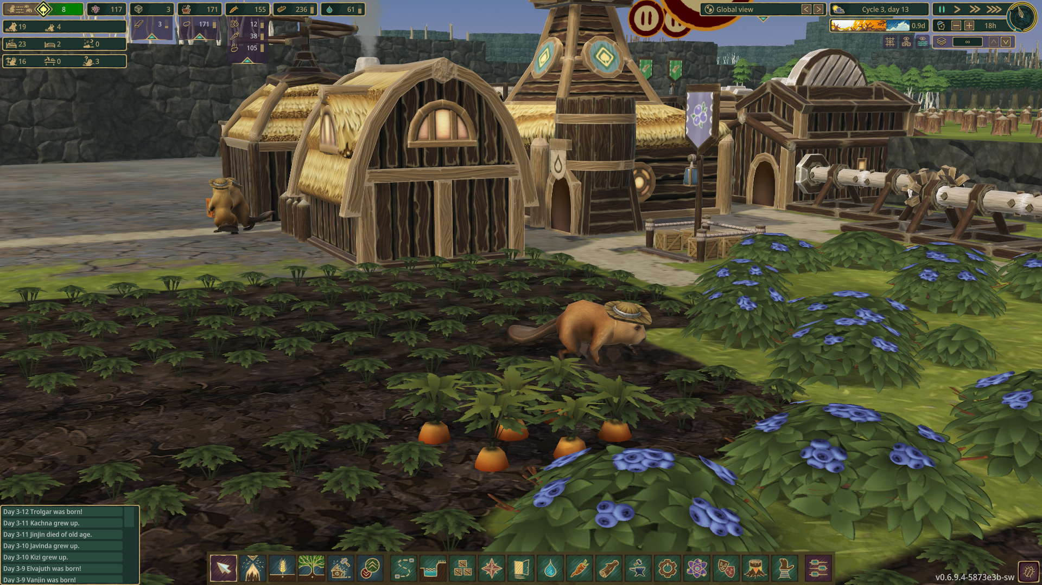
Hello!

Slide 5
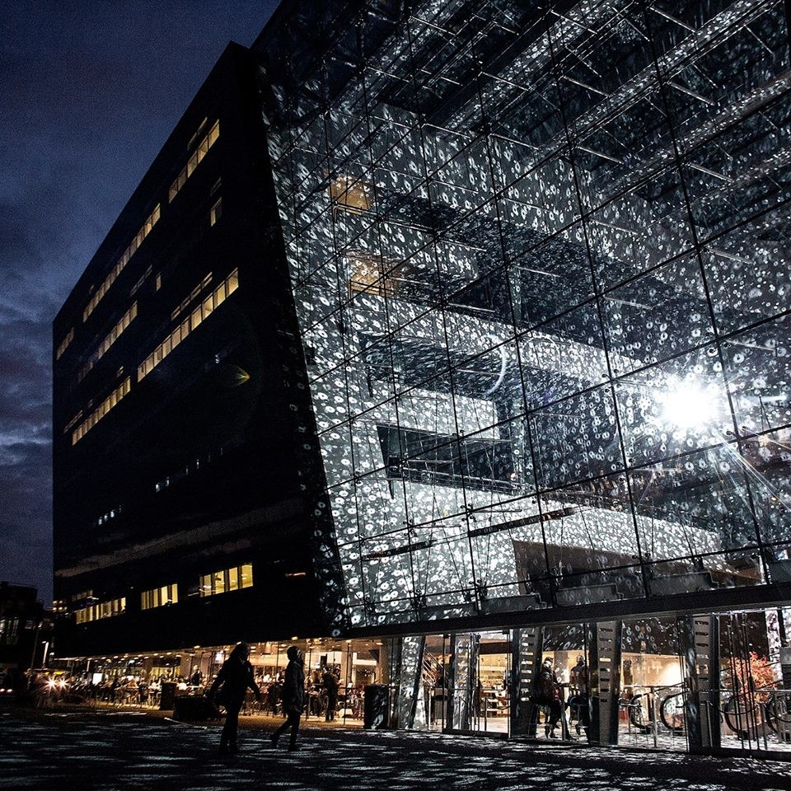
The Royal Danish Library
Black Diamond Flagship beside Danish Parliament
All over the country though, really
Includes the National Art Library (Kunstbibliotek)
National Photo Museum
Copenhagen and Aarhus University Libraries
Roskilde and IT University of CPH Libraries
And the old Statsbibliotek (Aarhus)
read more about the Black Diamond building
Notes:
Check out JAMOs Praha video

Slide 6
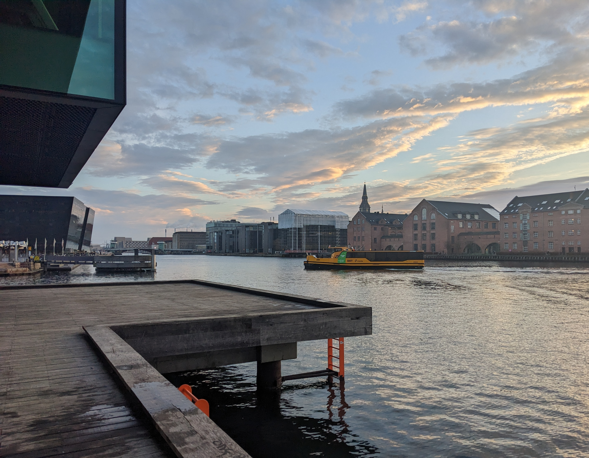

Slide 7
Legal Deposit
Is the foundation of the Danish national collections
2 copies of each publication are recieved by the "finisher” of the publication
Games are the only example of software deposits
Story time /
Episode 1 1697 First Legal Deposit "So that the King could have a nice book collection" -Jakob Moesgaard
1780 Kings’ book collection nationalised to become the National Library
1998 Several diverse media formats added to the Legal Deposit Agreement for the first time, including Games (
2005 Websites and ”broadcast media”, ”material made public in electronic broadcast networks”

Slide 8
Digital Cultural Heritage Collections
Hybrid digitized and born digital:
Radio, TV, newspapers, music, and podcasts from all over the country
Danish net archive for .dk domains
And…Games!

Slide 9

https://www.kb.dk/find-materiale/dr-arkivet/?locale=en

Slide 10
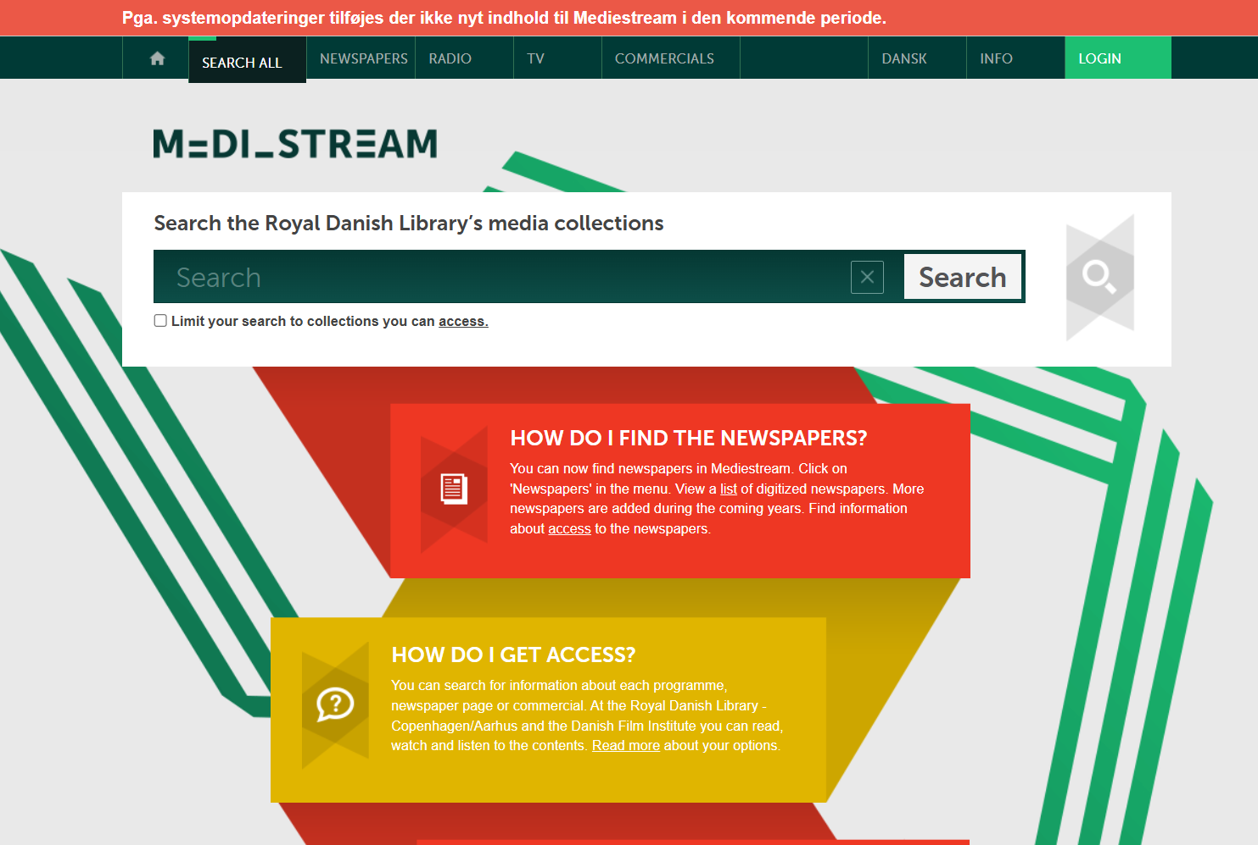

Slide 11
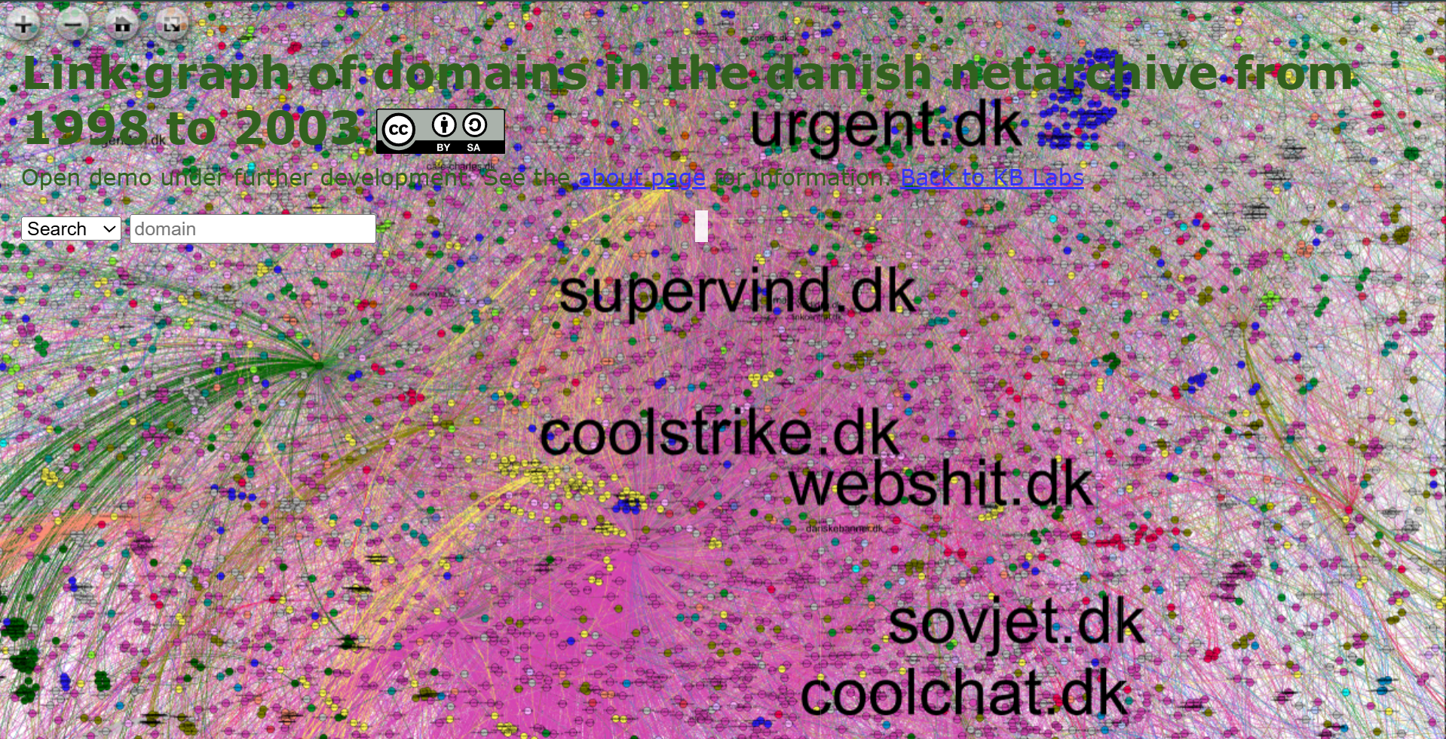
https://labs.statsbiblioteket.dk/linkgraph/1998_to_2003/

Slide 12
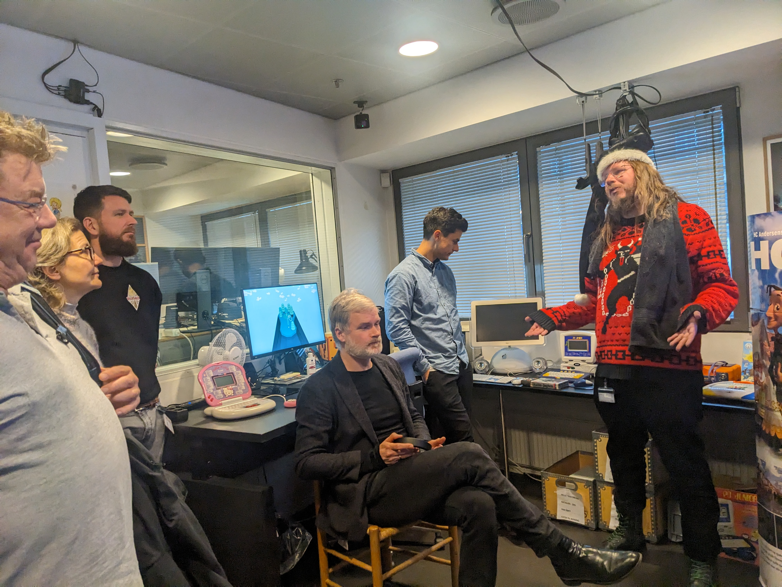
Games Lab
Welcome to the Games Lab!
Also Digital Forensics Lab
Games from 1963 to today
Consoles for all games in the collection
Emulation Equipment
Please book me to visit, if you are in CPH. asks@kb.dk

Slide 13
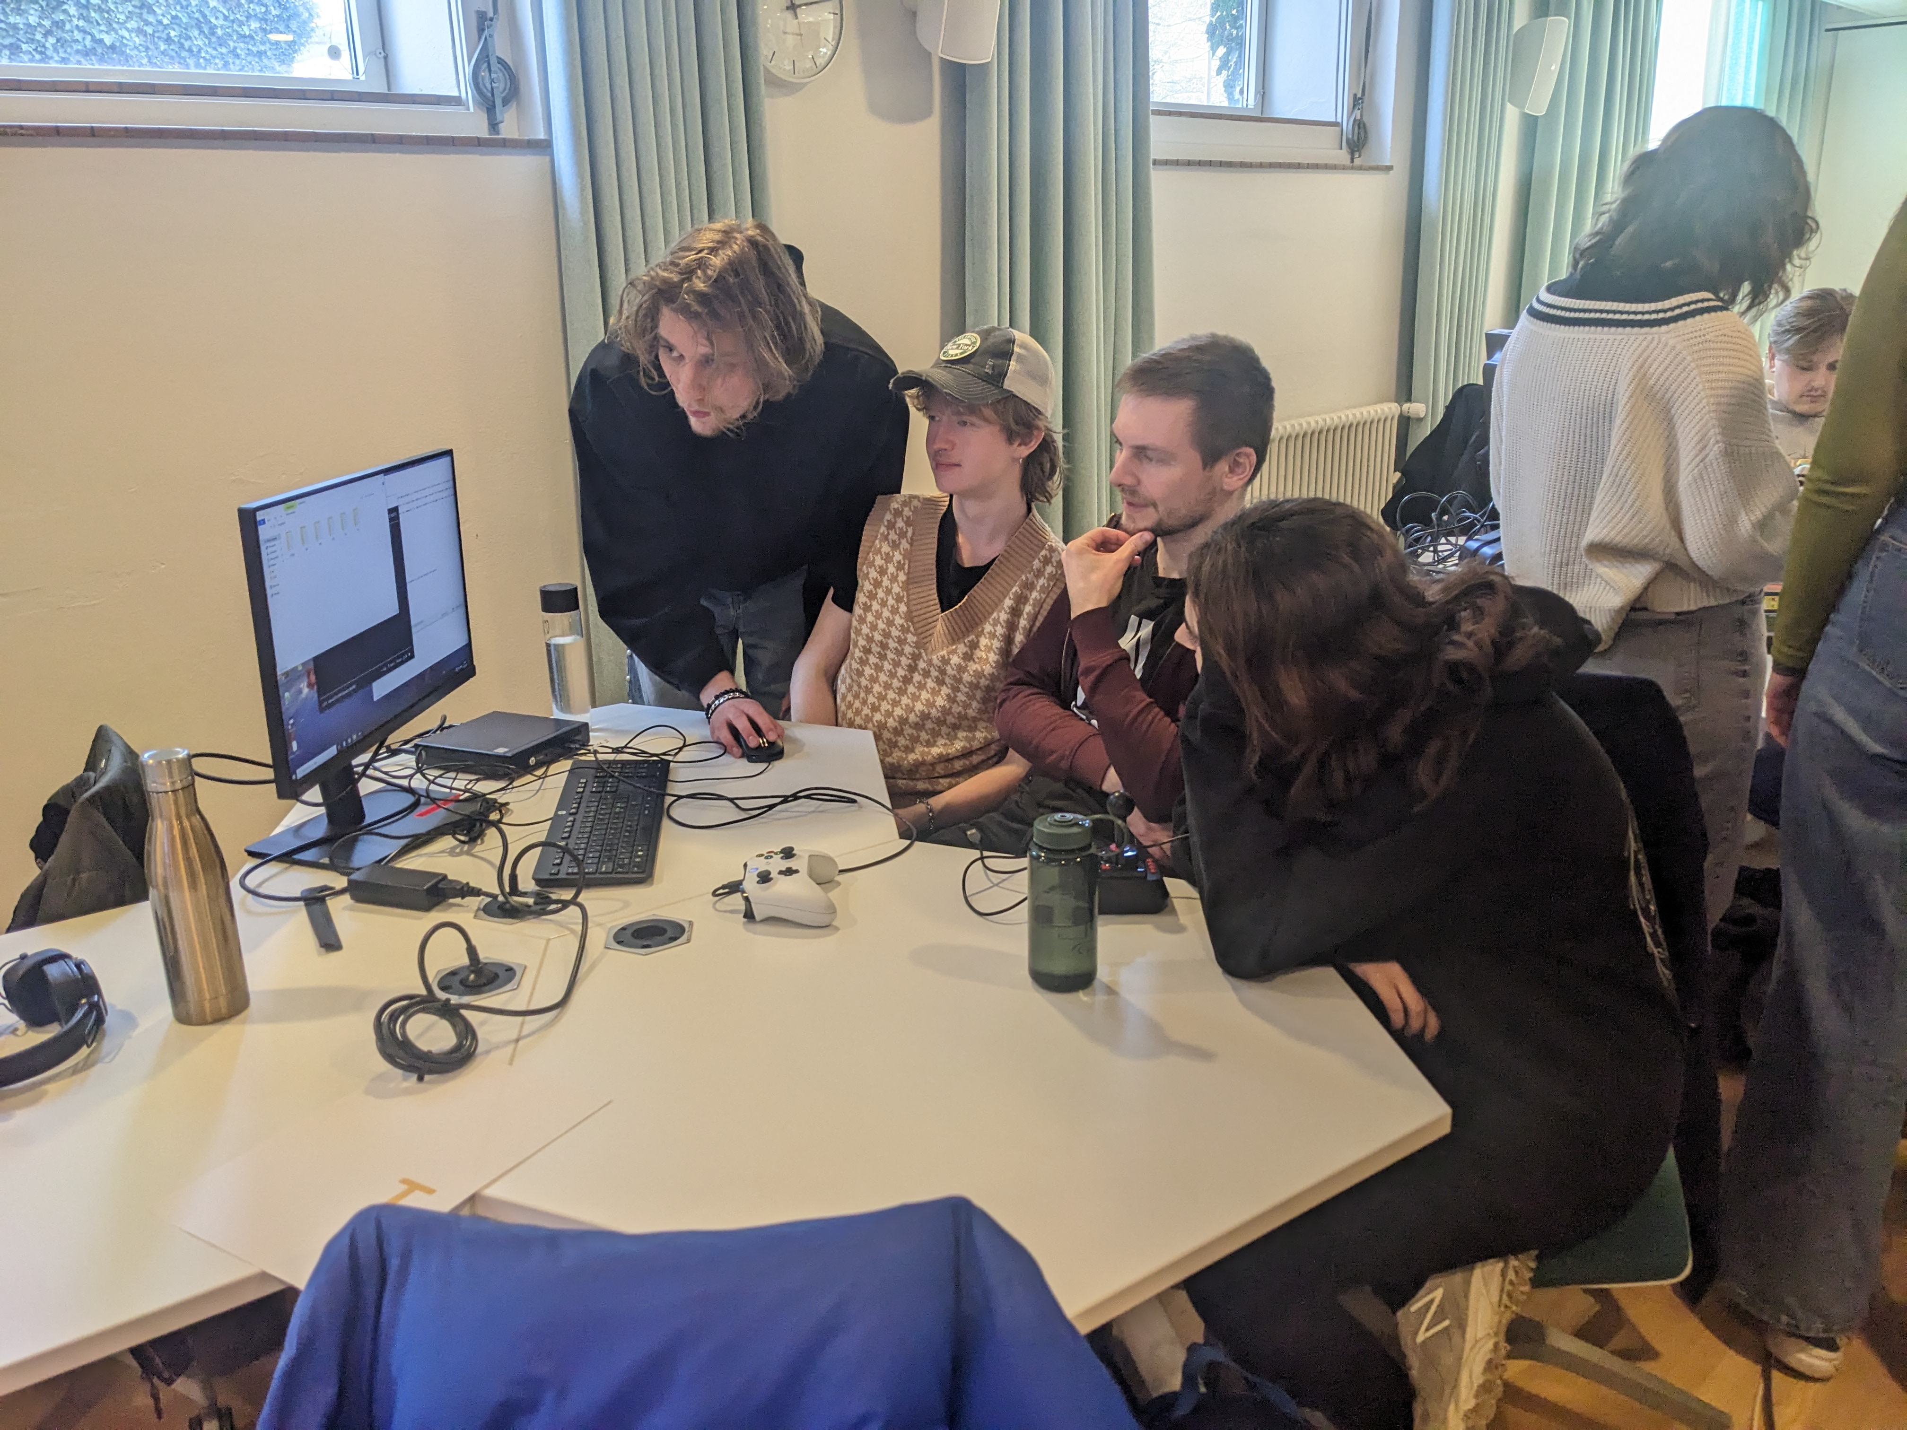
Games On Tour
Photo credit: Ashley Kelleher, Kongelige Bibliotek, 2025
Tour to AAH for Software Studies Bachelor's Students

Slide 14
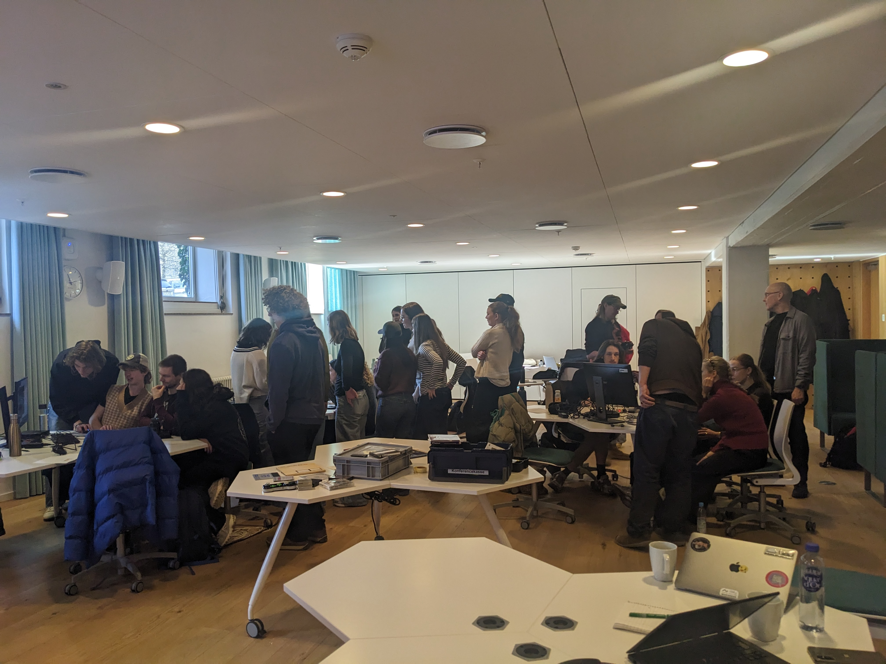
Photo credit: Ashley Kelleher, Kongelige Bibliotek, 2025

Slide 15
What is in the box?

Slide 16
Starting the Games Collection
The beginning of the accession and Registry of Danish Games as we know it today was created by our good colleague Jakob Moesgaard in 1998.

Slide 17
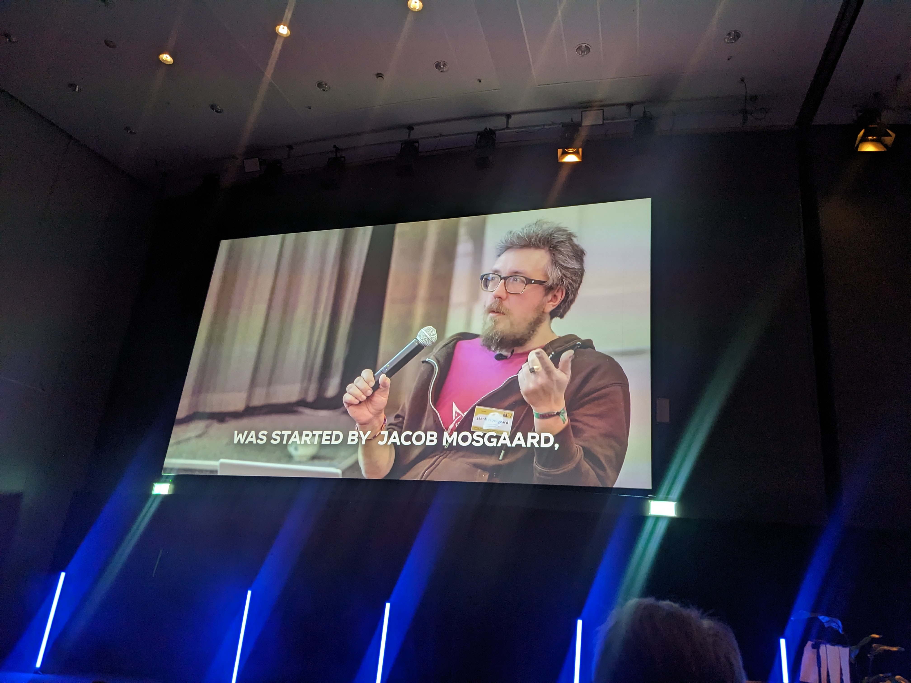
Photo credit: Ashley Kelleher, Kongelige Bibliotek, 2025

Slide 18
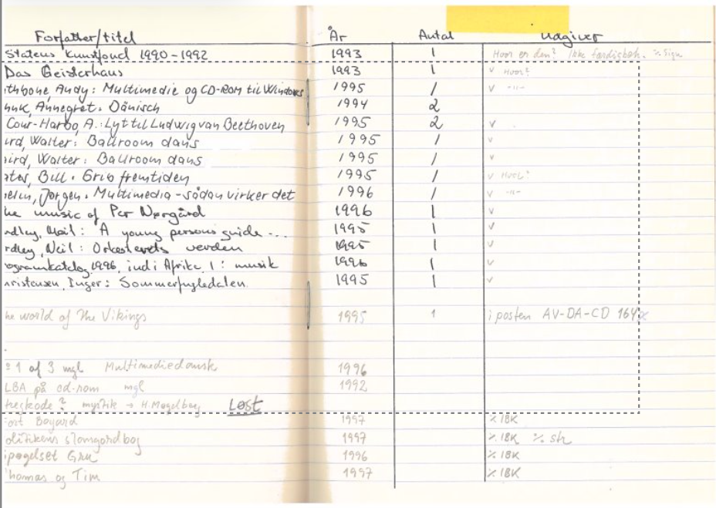
First Games Registered

Slide 19
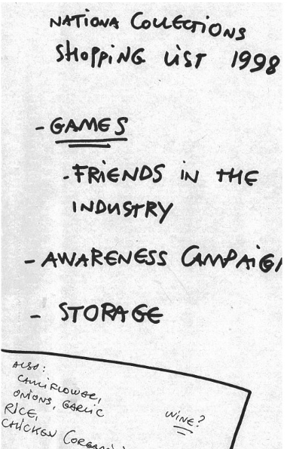
Evolving Practices
Because we have only started collecting in 1998, the practice is still evolving.
The games collection is basically as old as the Black Diamond building.
The Tea:
The games registry has always been kept in a series of spreadsheets
rips of games taken from our forensics lab, stored on internal storage and mapped for migration into a bit preservation environment
Photo credit: Jakob Moesgaard, Kongelige Bibliotek, 1998

Slide 20
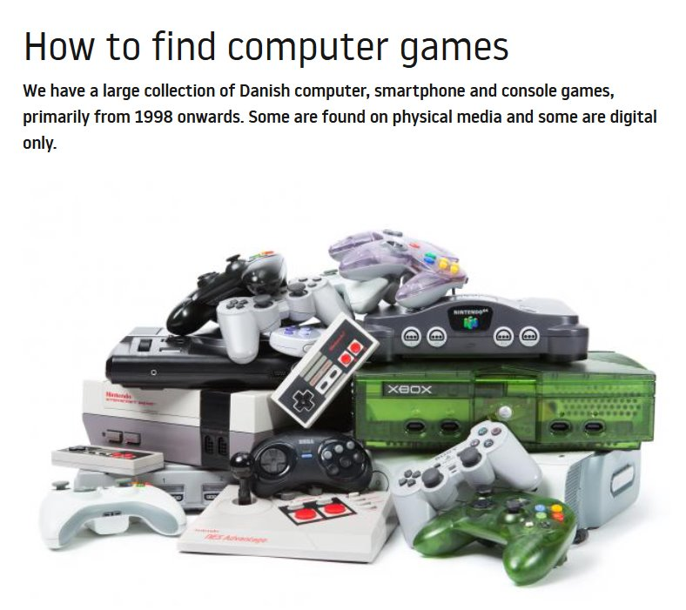
Access: How it started kb.dk

Slide 21
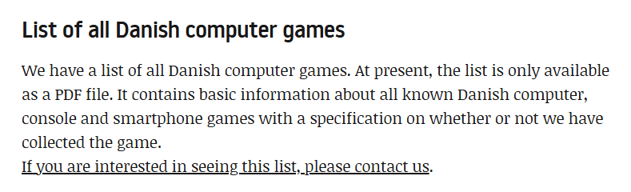
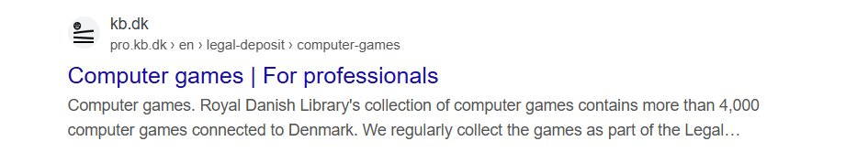
Like perhaps not the best accessibility solutions you have ever seen maybe

Slide 22
How it’s going
This is the dataset we will be working with today, with new titles added every month by our student helper Karl Dunn Grann.
New titles added by combination of monitored feeds i.e. Discord channels and Itch.io scraper into sheets, run on command (i.e. for Nordic Game Jam upcoming)

Slide 23
We ran a project: KULA-247 Games Registration
Autumn 2024
Intensive retro-cataloguing project to update and flesh out the Games Registry
Sponsored by the Danish Film Institute
Project Team: Madeleine Schlawitz (Department Lead, Digital Cultural Heritage) Ashley Kelleher (Project Lead) Allan Christophersen (Curator) Jakob Moesgaard (Collect ion Curator) Line Slot Hansen (Student Colleague) Karl Dunn Grann (Student Colleague)
With project collaborators Max Odsbjerg Pedersen (Data Consulting) Rasmus (Student Colleague)
To turn this...

Slide 24
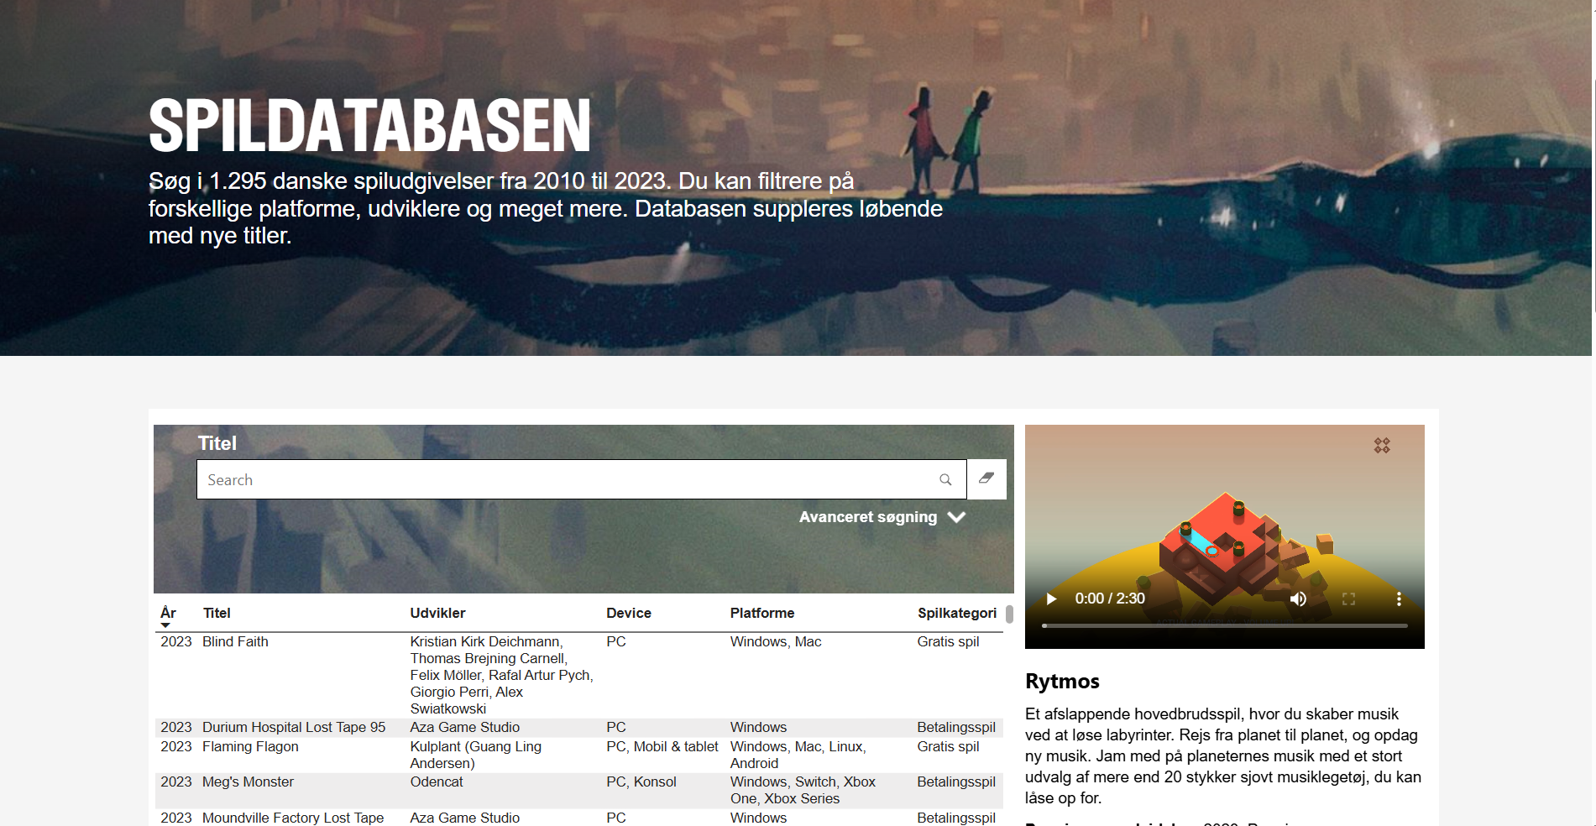

Slide 25
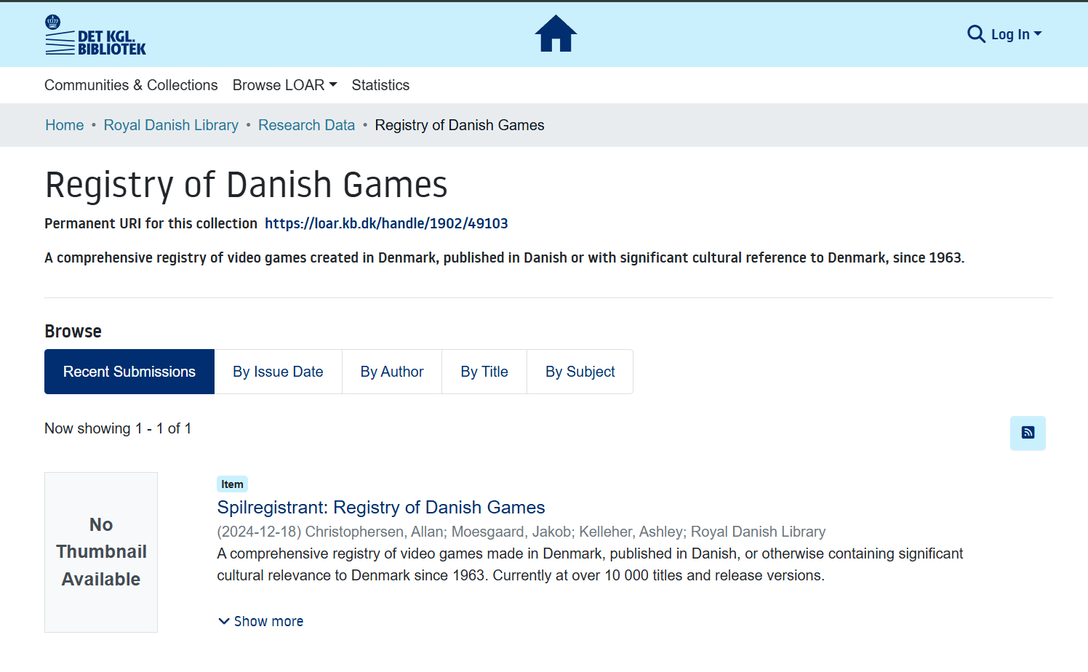

Slide 26
Wins
Date the Registry back to the first games made in Denmark in the 1960s
A lot of data cleanup, validation, and addition of new titles
Consolidation of existing knowledge of published games, student games, and game jam games between institutional records (Film Institute, Royal Library)
Brought the total from 1295 (DFI List) to over 10 000 entries
Agreement made between DR National broadcaster for children's games to be automatically deposited into the Library’s collections via Legal Deposit
Work on a template for standardized credit structure in games a la Film industrial standards
Examination of inclusion criteria, Legal Deposit Mandate criteria after 2005 (online material and releases become typical for games)

Slide 27
What's in the Registry
// Showcase on Games
_Hitman all of them
_Playdead Indie successes LIMBO and INSIDE
_Beloved Danish series for children include Hugo the troll, Pixeline in edutainment games

Slide 28
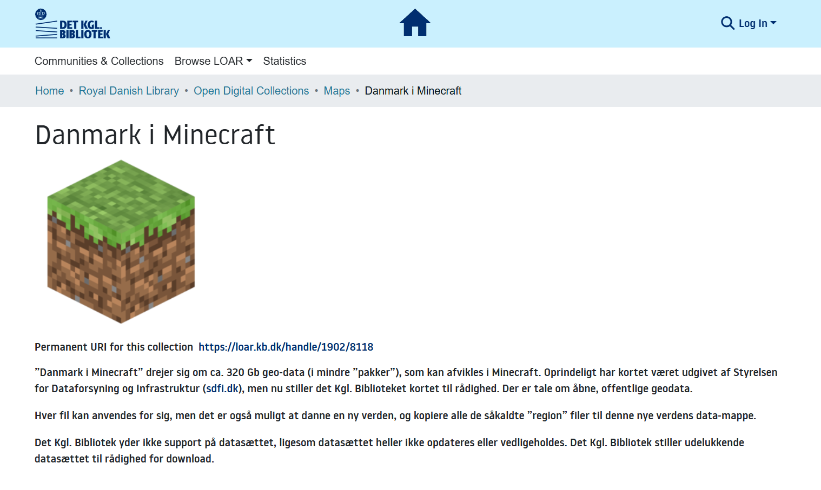
Find all 640 files at https://loar.kb.dk/collections/45f89370-686d-4c56-8f6a-ff35453f24f5

Slide 29

Hitman 1,2,3...

Slide 30
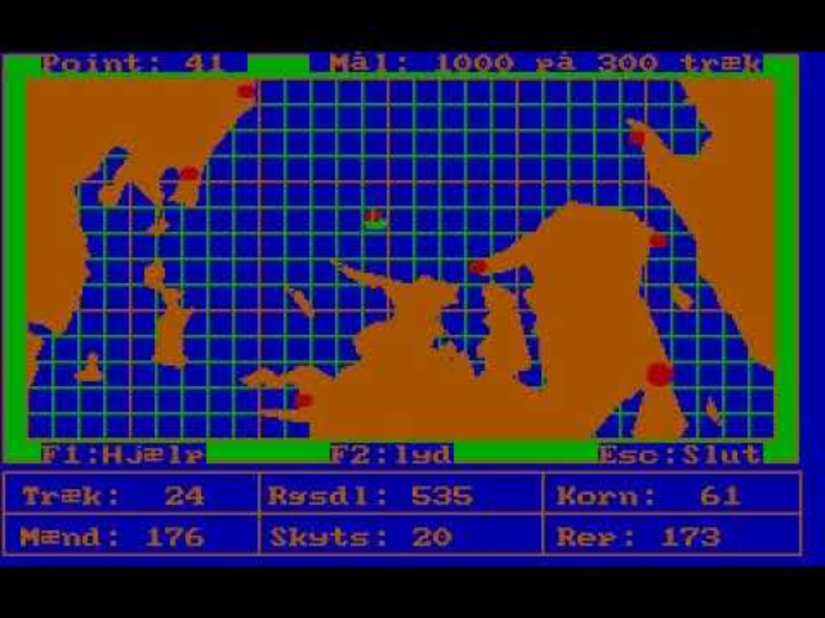
Kaptajn Kaper
_Kaptajn Kaper bc we have the sourcecode which is 🔥

Slide 31
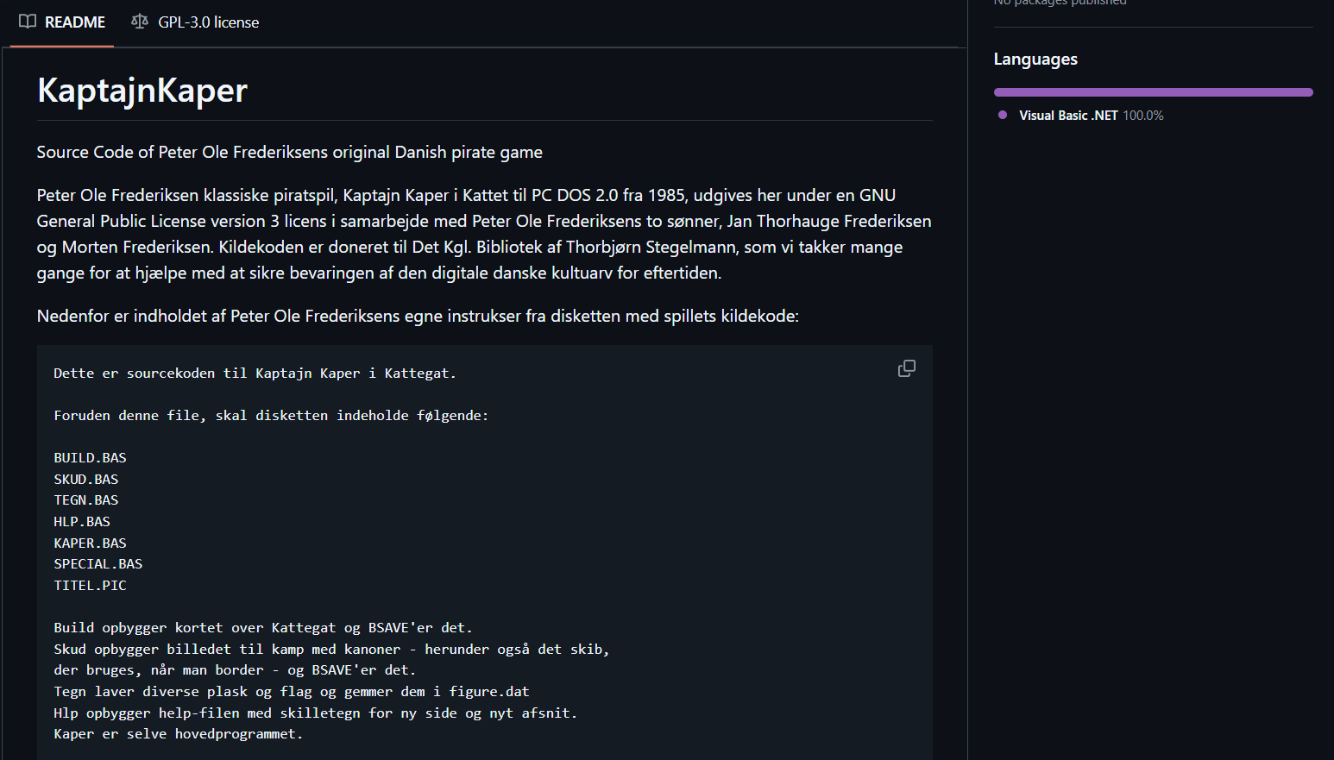
https://github.com/kb-dk/KaptajnKaper
https://youtu.be/N8QX5RSais8

Slide 32

Play this Game on Itch.io Built to bring the Guaman Poma, a treasured manuscript in the Danish Royal Library https://poma.kb.dk/permalink/2006/poma/info/en/frontpage.htm
to life

Slide 33
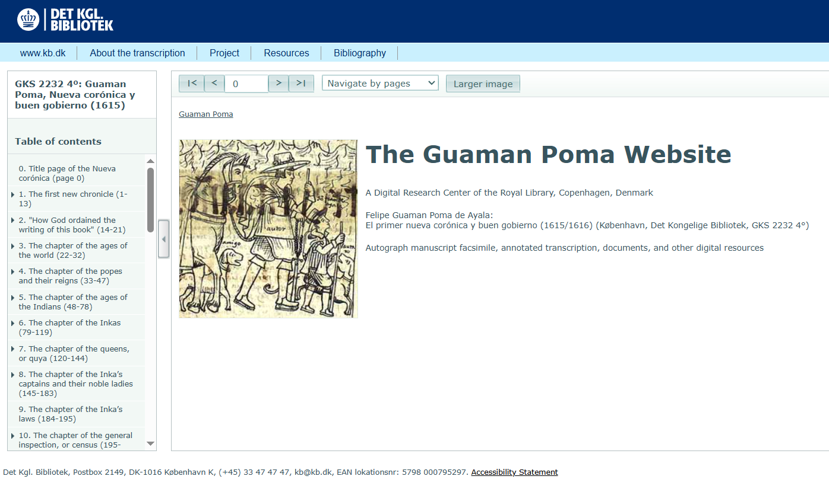

Slide 34
But...just how popular are Danish games? Asking for national collections everywhere
ARKADEN took to the streets of Copenhagen to consult the public

Slide 35
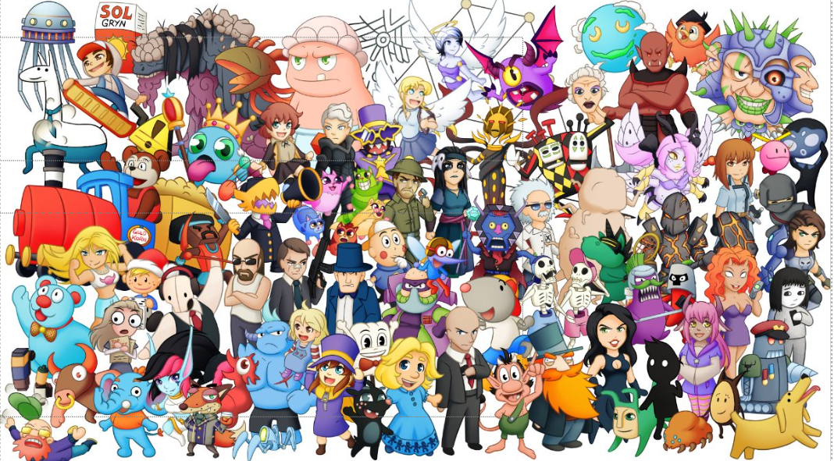
Illustrated by Lonnie T. Brandt (the-white-cat.com)

Slide 36

#DKGame Exhibition of games made in Denmark from 1960's to present
Most attended exhibition in the Royal Library’s history (at the Black Diamond)
Notably wide audience attendance as well (not only high-culture, relatively time-rich crowds, also families, children, YAs)

Slide 37

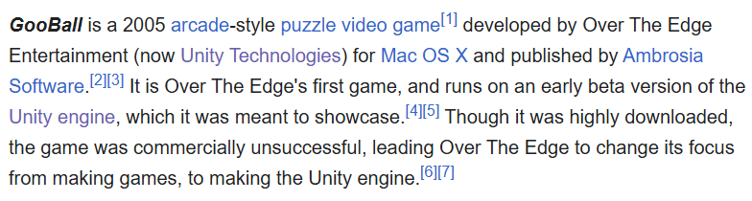
Development Evolution

Slide 38



https://nimbi.dk/
https://gamesdenmark.dk/

Slide 39
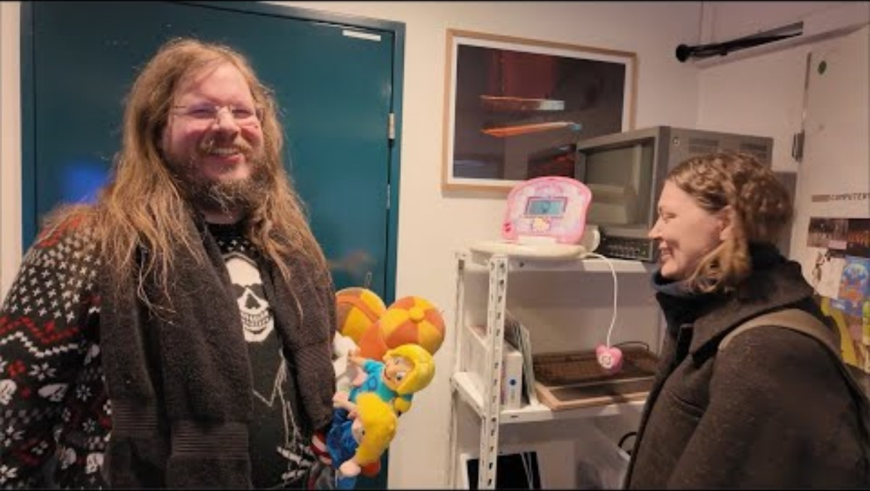
Danish Game Awards
https://spilprisen.dk/en/

Slide 40
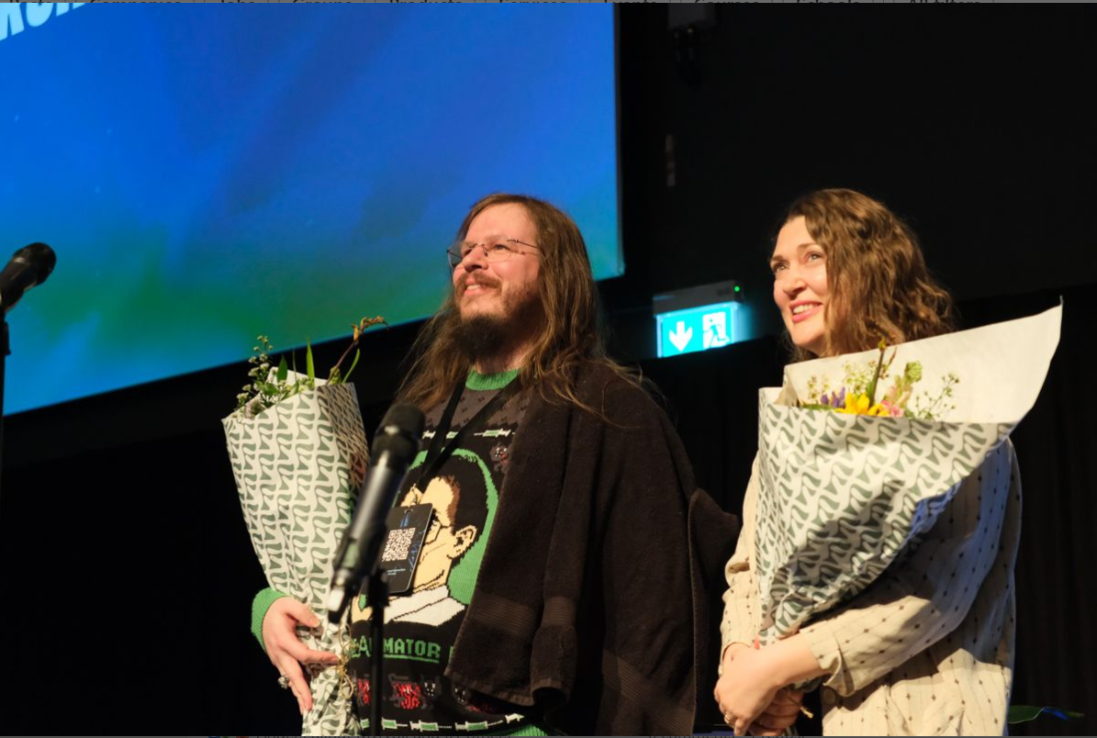

Slide 41

Next: Playing Games from the Collections Online, Brought to you by the European Out of Commerce Portal
https://www.euipo.europa.eu/en/observatory/awareness/ip-in-culture/out-of-commerce-works-portal

Slide 42
Get in touch!
Jakob Moesgaard @tatsavitr
jamo@kb.dk
Allan Christophersen
@duffadash@digipres.club
@duffadash.bsky.social
Ashley Kelleher
@akelleher.bsky.social asks@kb.dk Max Odsbjerg Pedersen https://github.com/maxodsbjerg
maop@kb.dk

Slide 43
Code-based data processing – Hands on!
RStudio Cloud
R
The qmd format
The tidytext principle
A small dataset

Slide 44
The Plan
Log in to Rstudio Cloud
Read in data to Rstudio Cloud
I will be walking through the code and you will repeat on your end
I will be demonstrating a step
You will repeat in your RStudio Cloud
We will move on when everybody has repeated the step
We will be getting errors and learning from them.

Slide 45
Get in touch!
Jakob Moesgaard @tatsavitr
jamo@kb.dk
Allan Christophersen
@duffadash@digipres.club
@duffadash.bsky.social
Ashley Kelleher
@akelleher.bsky.social asks@kb.dk Max Odsbjerg Pedersen https://github.com/maxodsbjerg
maop@kb.dk

